Slide 1
Introduction to Tensorflow and Keras
FEB 2019
Prepared by - Ishan

Slide 2
1
Introduction to Tensorflow
2
Tensorflow Program and Coding
3
Coding Neural Network in Tensorflow
4
Keras

Slide 3
1
Introduction to Tensorflow
2
Tensorflow Program and Coding
3
Coding Neural Network in Tensorflow
4
Keras

Slide 4

What is TensorFlow™?
Open source software library for numerical computation using data flow graphs
Originally developed by Google Brain Team to conduct machine learning and deep neural networks research
General enough to be applicable in a wide variety of other domains as well TensorFlow provides an extensive suite of functions and classes that allow users to build various models from scratch.

Slide 5
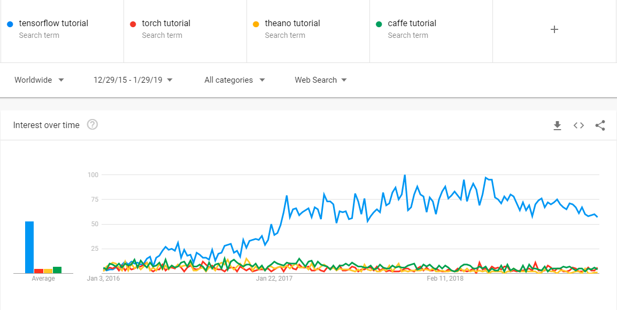
Why TensorFlow™?

Slide 6
Why TensorFlow™?
Python API
Portability: deploy computation to one or more CPUs or GPUs
Flexibility: from Android, iOS, Windows, Linux to server farms
Visualization (TensorBoard)
Checkpoints (for managing experiments)
Large community
Because Google !

Slide 7

Some companies using tensorflow

Slide 8
1
Introduction to Tensorflow
2
Tensorflow Program and Coding
3
Coding Neural Network in Tensorflow
4
Keras

Slide 9
Tensorflow Program
Tensorflow Program
Construction Phase
(assemble a graph)
Execution phase
(use a session to execute operations in the graph)

Slide 10
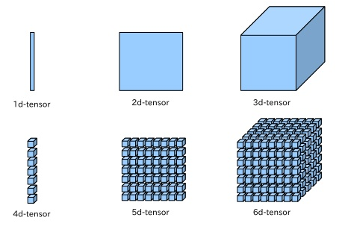
What is a tensor ?
An n-dimensional array or simply a data structure
0-d tensor: scalar (number)
1-d tensor: vector 2-d tensor: matrix
And so on

Slide 11
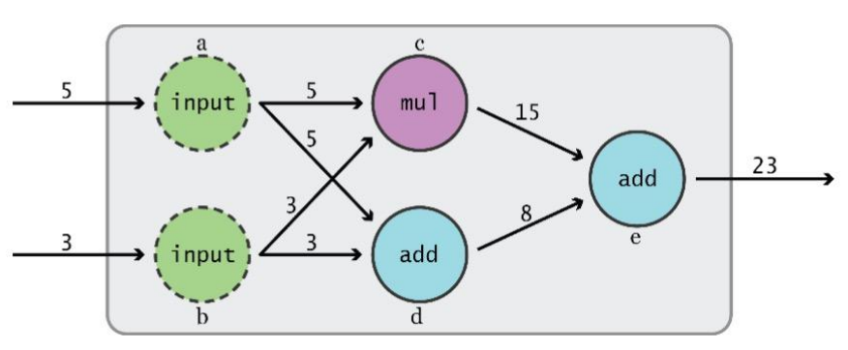

Data Flow Graphs
TensorFlow separates definition of computations from their execution

Slide 12
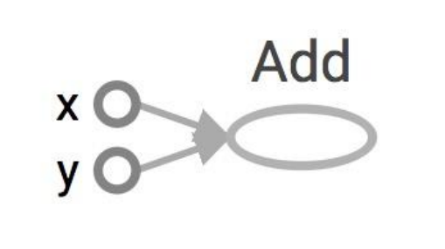
Data Flow Graphs
import tensorflow as tf
a = tf.add(3, 5)

Slide 13
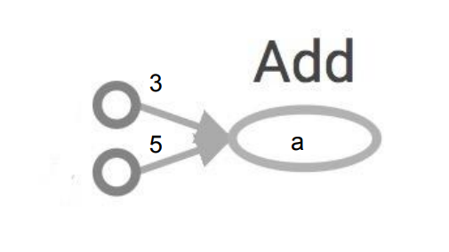
Data Flow Graphs
import tensorflow as tf
a = tf.add(3, 5)
Nodes: operators, variables, and constants
Edges: tensors Tensors are data.
Data Flow -> Tensor Flow!
Interpreted as

Slide 14
Data Flow Graphs
import tensorflow as tf
a = tf.add(3, 5)
print a
Nodes: operators, variables, and constants
Edges: tensors Tensors are data.
Data Flow -> Tensor Flow!
Interpreted as

Slide 15
Data Flow Graphs
import tensorflow as tf
a = tf.add(3, 5)
print a
>> Tensor("Add:0", shape=(), dtype=int32)
(Not 8)
Nodes: operators, variables, and constants
Edges: tensors Tensors are data.
Data Flow -> Tensor Flow!
Interpreted as

Slide 16
Data Flow Graphs : How to get the value of a?
Create a session
Assign it to variable sess so we can call it later
Within the session, evaluate the graph to fetch the value of a

Slide 17
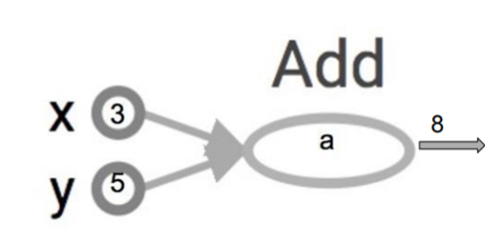
Data Flow Graphs : How to get the value of a?
import tensorflow as tf
a = tf.add(3, 5)
sess = tf.Session()
print sess.run(a)
sess.close()
The session will look at the graph, and think: How can I get the value of a?
then it computes all the nodes that leads to a.

Slide 18
tf.Session()
A Session object encapsulates the environment in which Operation objects are executed, and Tensor objects are evaluated.
In the single-process version of TensorFlow, sessions do not share any state. They may share the same graph (if they are both created with the same default graph), but the stateful components (such as the tf.Variable objects) will assume different values in the different sessions.
Session would’ve it own copy, unlike pointers in CPP
Changes made to X in one session wont effect the value of X in another
Eg : X= X+Y
X =3
Y =4
3
3
4
4
Session 1
Session 2
Session 1
Session 2

Slide 19
Tensorflow Program - Summary
Tensorflow Program
Construction Phase
import tensorflow as tf
a = tf.add(3, 5)
Execution phase
sess = tf.Session()
print sess.run(a)
sess.close()

Slide 20
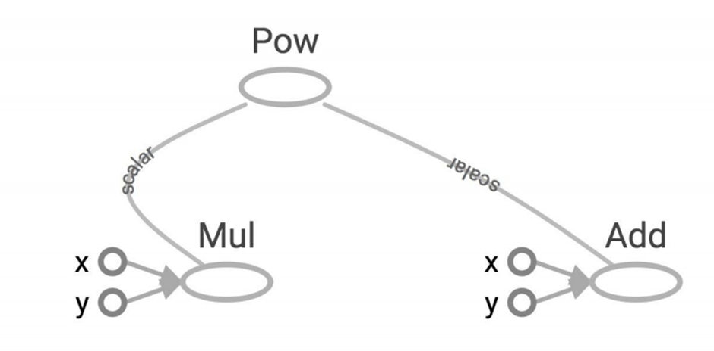
More Graphs
x = 2
y = 3
op1 = tf.add(x, y)
op2 = tf.mul(x, y)
op3 = tf.pow(op2, op1)
with tf.Session() as sess:
op3 = sess.run(op3)

Slide 21
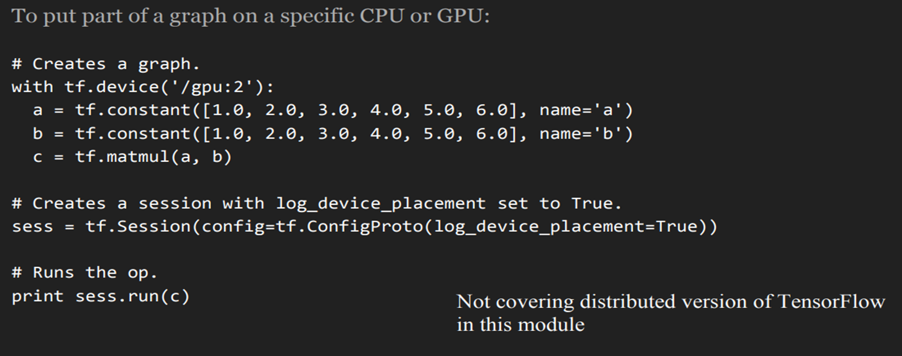
Distributed Computation – Power of TF
Possible to break graphs into several chunks and run them parallelly across multiple CPUs, GPUs, or devices

Slide 22

Coding Time ! Here we will write first TF program and see how we can visualize using Tensorboard
C:\Users\... > jupyter notebook

Slide 23
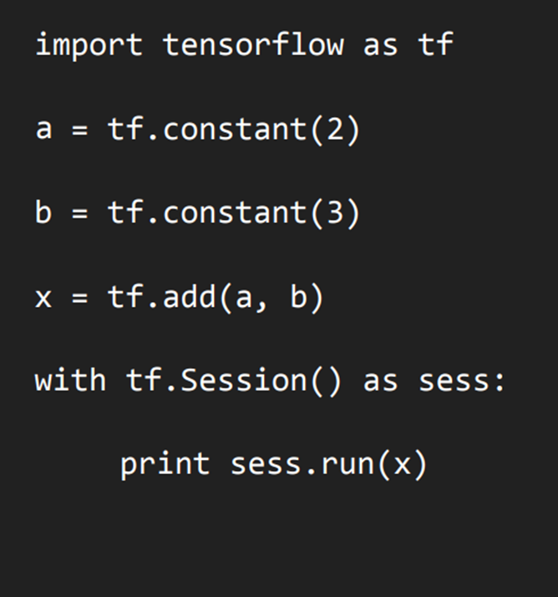
First tensorflow program

Slide 24
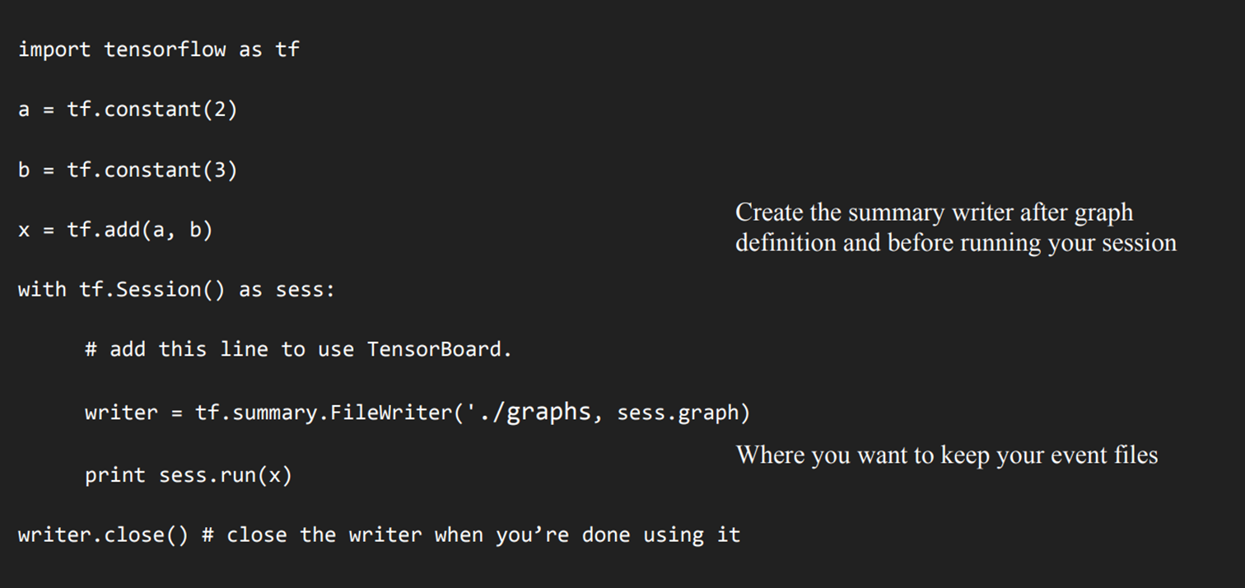
Using Tensorboard
For python 3 add brackets to print statement and ‘./graphs‘

Slide 25
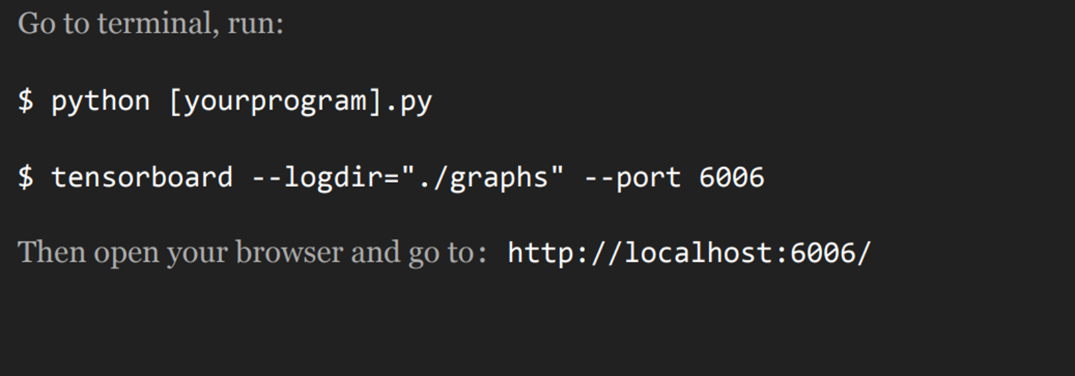
Running tensorboard

Slide 26
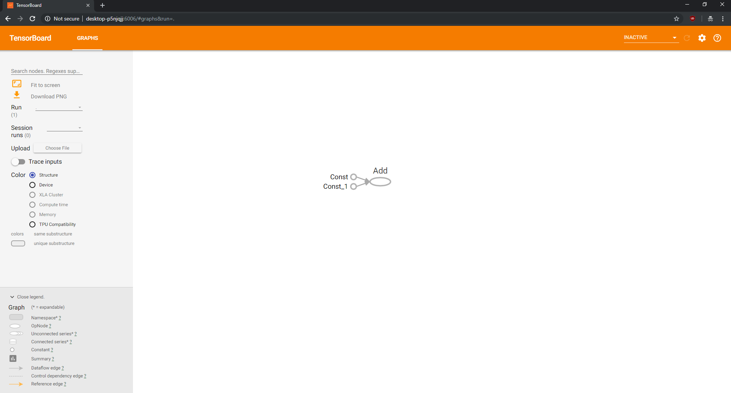

Slide 27
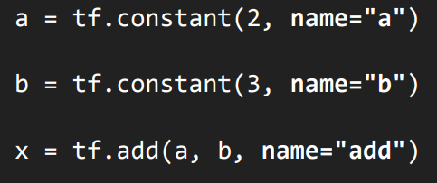
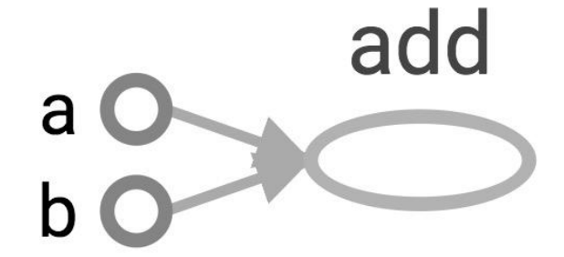
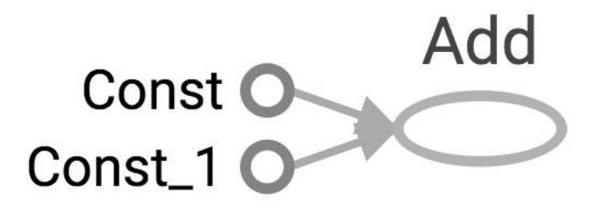
Changing the variable names

Slide 28
Learn to use TensorBoard well and often. It will help a lot when you build complicated models.

Slide 29
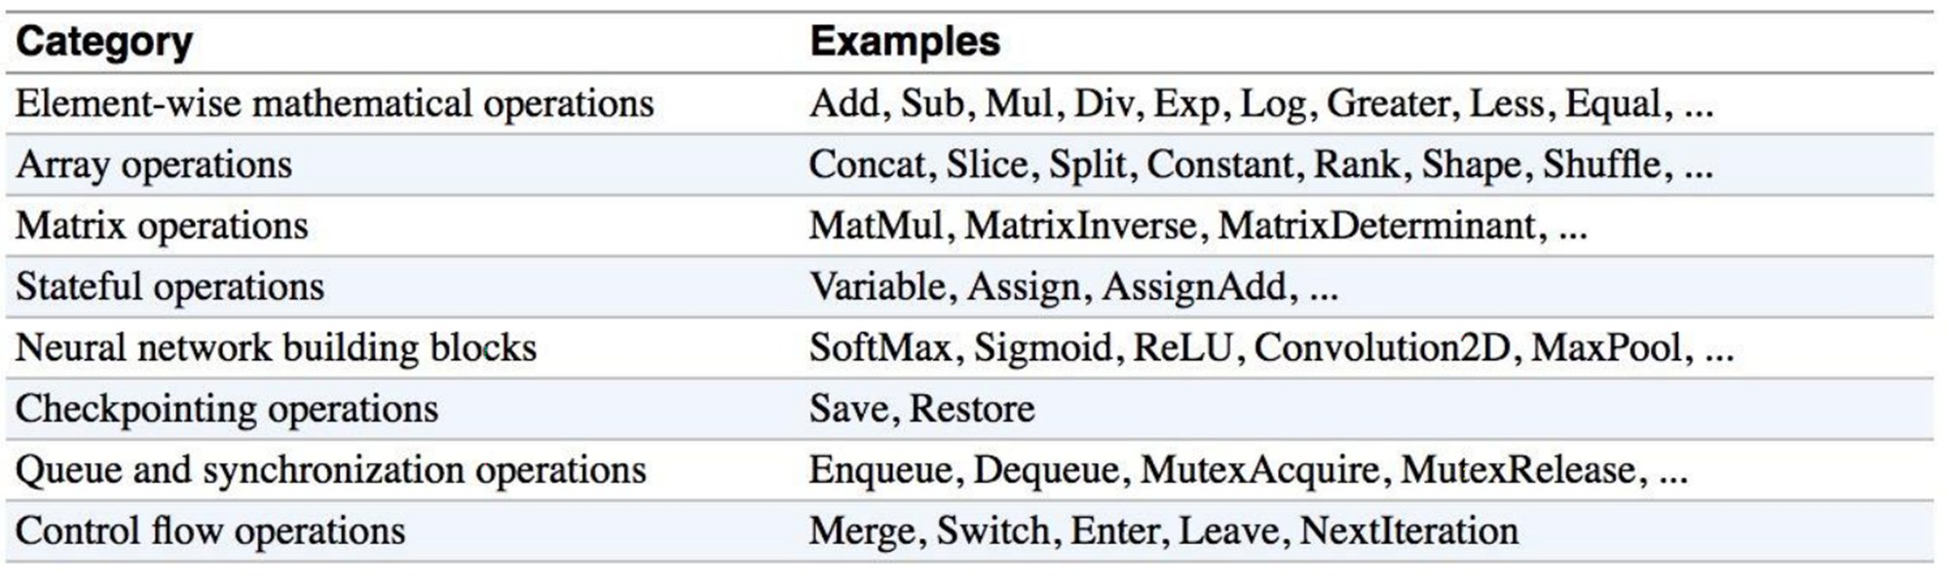
Some Tensorflow Operations
Notes:
abs(...): Computes the absolute value of a tensor.
accumulate_n(...): Returns the element-wise sum of a list of tensors.
acos(...): Computes acos of x element-wise.
acosh(...): Computes inverse hyperbolic cosine of x element-wise.
add(...): Returns x + y element-wise.
add_n(...): Adds all input tensors element-wise.
angle(...): Returns the element-wise argument of a complex (or real) tensor.
argmax(...): Returns the index with the largest value across axes of a tensor. (deprecated arguments)
argmin(...): Returns the index with the smallest value across axes of a tensor. (deprecated arguments)
asin(...): Computes asin of x element-wise.
asinh(...): Computes inverse hyperbolic sine of x element-wise.
atan(...): Computes atan of x element-wise.
atan2(...): Computes arctangent of y/x element-wise, respecting signs of the arguments.
atanh(...): Computes inverse hyperbolic tangent of x element-wise.
bessel_i0(...): Computes the Bessel i0 function of x element-wise.
bessel_i0e(...): Computes the Bessel i0e function of x element-wise.
bessel_i1(...): Computes the Bessel i1 function of x element-wise.
bessel_i1e(...): Computes the Bessel i1e function of x element-wise.
betainc(...): Compute the regularized incomplete beta integral Ix(a,b).
bincount(...): Counts the number of occurrences of each value in an integer array.
ceil(...): Returns element-wise smallest integer not less than x.
confusion_matrix(...): Computes the confusion matrix from predictions and labels.
conj(...): Returns the complex conjugate of a complex number.
cos(...): Computes cos of x element-wise.
cosh(...): Computes hyperbolic cosine of x element-wise.
count_nonzero(...): Computes number of nonzero elements across dimensions of a tensor. (deprecated arguments)
cumprod(...): Compute the cumulative product of the tensor x along axis.
cumsum(...): Compute the cumulative sum of the tensor x along axis.
digamma(...): Computes Psi, the derivative of Lgamma (the log of the absolute value of
divide(...): Computes Python style division of x by y.
equal(...): Returns the truth value of (x == y) element-wise.
erf(...): Computes the Gauss error function of x element-wise.
erfc(...): Computes the complementary error function of x element-wise.
exp(...): Computes exponential of x element-wise. y=ex.
expm1(...): Computes exponential of x - 1 element-wise.
floor(...): Returns element-wise largest integer not greater than x.
floordiv(...): Divides x / y elementwise, rounding toward the most negative integer.
greater(...): Returns the truth value of (x > y) element-wise.
greater_equal(...): Returns the truth value of (x >= y) element-wise.
igamma(...): Compute the lower regularized incomplete Gamma function P(a, x).
igammac(...): Compute the upper regularized incomplete Gamma function Q(a, x).
imag(...): Returns the imaginary part of a complex (or real) tensor.
in_top_k(...): Says whether the targets are in the top K predictions.
invert_permutation(...): Computes the inverse permutation of a tensor.
is_finite(...): Returns which elements of x are finite.
is_inf(...): Returns which elements of x are Inf.
is_nan(...): Returns which elements of x are NaN.
is_non_decreasing(...): Returns True if x is non-decreasing.
is_strictly_increasing(...): Returns True if x is strictly increasing.
l2_normalize(...): Normalizes along dimension axis using an L2 norm. (deprecated arguments)
lbeta(...): Computes ln(|Beta(x)|), reducing along the last dimension.
less(...): Returns the truth value of (x < y) element-wise.
less_equal(...): Returns the truth value of (x <= y) element-wise.
lgamma(...): Computes the log of the absolute value of Gamma(x) element-wise.
log(...): Computes natural logarithm of x element-wise.
log1p(...): Computes natural logarithm of (1 + x) element-wise.
log_sigmoid(...): Computes log sigmoid of x element-wise.
log_softmax(...): Computes log softmax activations. (deprecated arguments)
logical_and(...): Returns the truth value of x AND y element-wise.
logical_not(...): Returns the truth value of NOT x element-wise.
logical_or(...): Returns the truth value of x OR y element-wise.
logical_xor(...): x ^ y = (x | y) & ~(x & y).
maximum(...): Returns the max of x and y (i.e. x > y ? x : y) element-wise.
minimum(...): Returns the min of x and y (i.e. x < y ? x : y) element-wise.
multiply(...): Returns x * y element-wise.
negative(...): Computes numerical negative value element-wise.
not_equal(...): Returns the truth value of (x != y) element-wise.
polygamma(...): Compute the polygamma function ψ(n)(x).
polyval(...): Computes the elementwise value of a polynomial.
pow(...): Computes the power of one value to another.
real(...): Returns the real part of a complex (or real) tensor.
reciprocal(...): Computes the reciprocal of x element-wise.
reduce_all(...): Computes the "logical and" of elements across dimensions of a tensor. (deprecated arguments)
reduce_any(...): Computes the "logical or" of elements across dimensions of a tensor. (deprecated arguments)
reduce_logsumexp(...): Computes log(sum(exp(elements across dimensions of a tensor))). (deprecated arguments)
reduce_max(...): Computes the maximum of elements across dimensions of a tensor. (deprecated arguments)
reduce_mean(...): Computes the mean of elements across dimensions of a tensor.
reduce_min(...): Computes the minimum of elements across dimensions of a tensor. (deprecated arguments)
reduce_prod(...): Computes the product of elements across dimensions of a tensor. (deprecated arguments)
reduce_std(...): Computes the standard deviation of elements across dimensions of a tensor.
reduce_sum(...): Computes the sum of elements across dimensions of a tensor. (deprecated arguments)
reduce_variance(...): Computes the variance of elements across dimensions of a tensor.
rint(...): Returns element-wise integer closest to x.
round(...): Rounds the values of a tensor to the nearest integer, element-wise.
rsqrt(...): Computes reciprocal of square root of x element-wise.
scalar_mul(...): Multiplies a scalar times a Tensor or IndexedSlices object.
segment_max(...): Computes the maximum along segments of a tensor.
segment_mean(...): Computes the mean along segments of a tensor.
segment_min(...): Computes the minimum along segments of a tensor.
segment_prod(...): Computes the product along segments of a tensor.
segment_sum(...): Computes the sum along segments of a tensor.
sigmoid(...): Computes sigmoid of x element-wise.
sign(...): Returns an element-wise indication of the sign of a number.
sin(...): Computes sin of x element-wise.
sinh(...): Computes hyperbolic sine of x element-wise.
softmax(...): Computes softmax activations. (deprecated arguments)
softplus(...): Computes softplus: log(exp(features) + 1).
softsign(...): Computes softsign: features / (abs(features) + 1).
sqrt(...): Computes square root of x element-wise.
square(...): Computes square of x element-wise.
squared_difference(...): Returns (x - y)(x - y) element-wise.
subtract(...): Returns x - y element-wise.
tan(...): Computes tan of x element-wise.
tanh(...): Computes hyperbolic tangent of x element-wise.
top_k(...): Finds values and indices of the k largest entries for the last dimension.
truediv(...): Divides x / y elementwise (using Python 3 division operator semantics).
unsorted_segment_max(...): Computes the maximum along segments of a tensor.
unsorted_segment_mean(...): Computes the mean along segments of a tensor.
unsorted_segment_min(...): Computes the minimum along segments of a tensor.
unsorted_segment_prod(...): Computes the product along segments of a tensor.
unsorted_segment_sqrt_n(...): Computes the sum along segments of a tensor divided by the sqrt(N).
unsorted_segment_sum(...): Computes the sum along segments of a tensor.
xdivy(...): Returns 0 if x == 0, and x / y otherwise, elementwise.
xlogy(...): Returns 0 if x == 0, and x * log(y) otherwise, elementwise.
zero_fraction(...): Returns the fraction of zeros in value.
zeta(...): Compute the Hurwitz zeta function ζ(x,q).

Slide 30
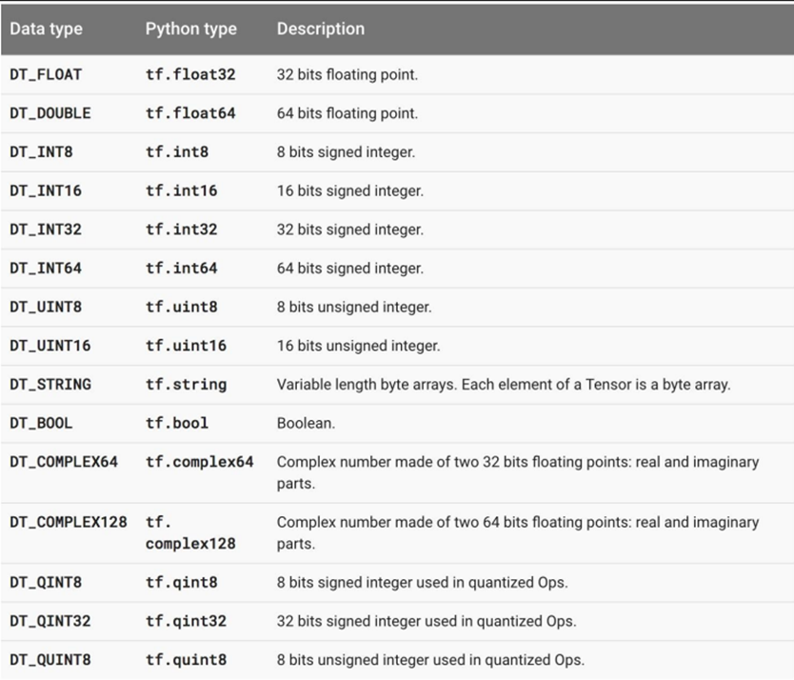
Some Tensorflow Datatypes

Slide 31
Coding Time !
Write a TF program to find cost of item after discount and visualize using tensorboard
Hint: Final_price = Current_price – (Current_price * Discount)/100

Slide 32
1
Introduction to Tensorflow
2
Tensorflow Program and Coding
3
Neural Networks for Handwritten Digits
4
Coding Neural Network in Tensorflow

Slide 33

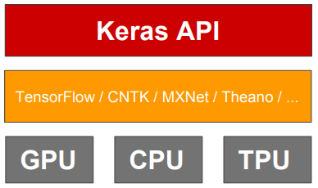
What is Keras ?
Keras is an open source neural network library written in Python.
It is capable of running on top of TensorFlow.
Designed to enable fast experimentation with deep neural networks, it focuses on being user-friendly, modular, and extensible

Slide 34
Three API Styles for Keras
The Sequential Model
Dead simple
Only for single-input, single-output, sequential layer stacks
Good for 70+% of use cases
The functional API
Like playing with Lego bricks
Multi-input, multi-output, arbitrary static graph topologies
Good for 95% of use cases
Model subclassing
Maximum flexibility
Larger potential error surface

Slide 35
Different API Styles for Keras - The Sequential Model
The Sequential Model | The functional API | Model subclassing
It’s intuitive, concise, and appropriate for 95% of ML problems in practice. Using this API, you can write your first neural network in about 10 lines of code. | Of course, a sequential model is a simple stack of layers that cannot represent arbitrary models. More advanced models can be built using the Functional API, which enables you to define complex topologies, including multi-input and multi-output models, models with shared layers, and models with residual connections. | Fully customizable models can be built by using the Model Subclassing API, You define your own forward pass imperatively in this style, in the body of a class method.
The most common way to define your model is by building a graph of layers, which corresponds to the mental model we normally use when we think about deep learning. The simplest type of model is a stack of layers. | When building models with the functional API, layers are callable (on a tensor), and return a tensor as output. These input tensor(s) and output tensor(s) can then be used to define a model. | These models are more flexible, but can be harder to debug.
model = tf.keras.Sequential() model.add(layers.Dense(64, activation=’relu’)) model.add(layers.Dense(64, activation=’relu’)) model.add(layers.Dense(10, activation=’softmax’)) model.compile(optimizer=’adam’, loss=’sparse_categorical_crossentropy’, metrics=[‘accuracy’]) model.fit(x_train, y_train, epochs=5) model.evaluate(x_test, y_test) | inputs = tf.keras.Input(shape=(32,)) # A layer instance is callable on a tensor, and returns a tensor. x = layers.Dense(64, activation=’relu’)(inputs) x = layers.Dense(64, activation=’relu’)(x) predictions = layers.Dense(10, activation=’softmax’)(x) # Instantiate the model given inputs and outputs. model = tf.keras.Model(inputs=inputs, outputs=predictions) | class MyModel(tf.keras.Model): def __init__(self): super(MyModel, self).__init__() # Define your layers here. self.dense_1 = layers.Dense(32, activation=’relu’) self.dense_2 = layers.Dense(num_classes, activation=’sigmoid’) def call(self, inputs): # Define your forward pass here, # using layers you previously defined in `__init__` x = self.dense_1(inputs) return self.dense_2(x)

